Slide 1
Machine Learning Algorithms for Disease Occurrence Prediction
A Comparison of various Machine Learning Algorithms HARSHA BHUVANA RIKHITH DEVARASETTY DINESH NANNAPANANENI GUNASHEKHARA REDDY GORRE JASHWANTH KANDERI DATA LAKERS

Slide 2
Introduction
Objective: To compare multiple machine learning algorithms for predicting disease occurrences.
Dataset: Disease occurrence data with various features.
Algorithms Compared: Decision Tree, Logistic Regression, Random Forest, K-Nearest Neighbors (KNN).

Slide 3
Dataset Overview
Features: The dataset includes various features such as age, gender, and other environmental factors affecting disease occurrences.
Target Variable: Disease occurrence count or classification label.
Data Split: 80% training, 20% testing.

Slide 4
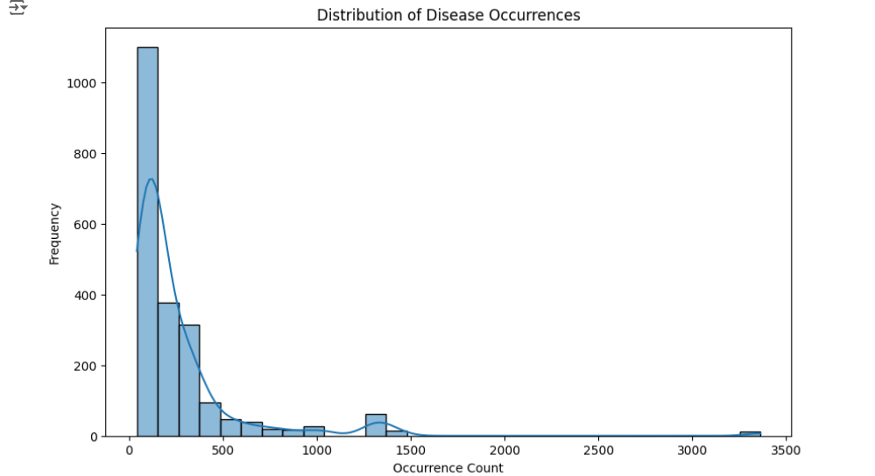
EDA(Exploratory Data Analysis)
Skewed Distribution: The histogram shows a right-skewed distribution of disease occurrences, with the majority of occurrences concentrated in the lower range (0–500).
High Frequency at Low Counts: Most diseases have low occurrence counts, as indicated by the tall bar near the left, peaking around 0–200.
Decreasing Frequency: The frequency of disease occurrences decreases significantly as the count increases, with only a few diseases having counts above 1000.
Outliers: A small number of diseases have very high occurrence counts (above 3000), represented by the sparse bars on the far right.

Slide 5
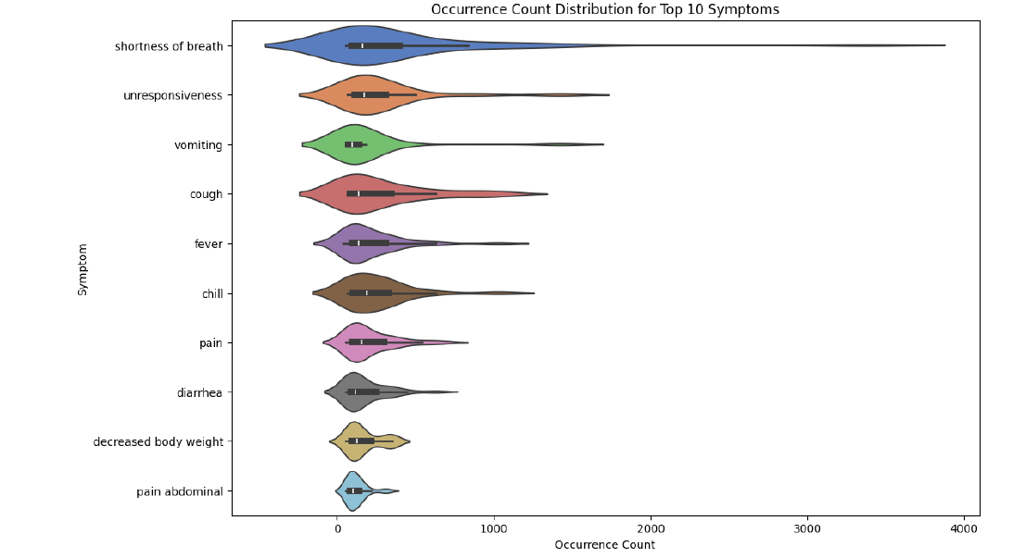
EDA(Exploratory Data Analysis)
Top Symptom: Shortness of Breath has the highest occurrence and widest distribution, indicating it's the most frequently reported symptom with significant variability.
Moderate Symptoms: Unresponsiveness, Vomiting, Cough, and Fever show moderate occurrence counts with notable variability.
Least Reported Symptoms: Decreased Body Weight and Abdominal Pain have the smallest distributions and lowest occurrence counts.
Statistical Insights: Each symptom's violin plot highlights the distribution density, with the median, interquartile range, and data spread indicated by the embedded boxplot.

Slide 6
Methodology
Step 1: Data Preprocessing and Feature Selection
Step 2: Model Training on the entire dataset
Step 3: Evaluation using accuracy, precision, recall, and F1-score
Step 4: Comparison of algorithms

Slide 7
Algorithm 1 – Decision Tree
Overview: A tree-based algorithm that splits data into nodes based on feature thresholds.
Key Parameters: Max depth = 10, min samples split = 5, number of estimators = 100.
Results: Accuracy on the entire dataset: 0.973154324161074

Slide 8
Algorithm 2 – Logistic Regression
Overview: A linear classifier that models the relationship between the features and the target.
Key Parameters: Regularization type = L2, solver = liblinear.
Results: Accuracy on the dataset: 0.9731543624161074
Pros: Simple and fast, good for linearly separable data.
Cons: Struggles with non-linear data.

Slide 9
Algorithm 3 – Random Forest
Overview: An ensemble method that combines multiple decision trees for improved accuracy.
Key Parameters: n_estimators = 100, max_depth = 10, min_samples_split = 5.
Results: Best overall accuracy: 0.9261744966442953
Advantages: Handles overfitting well, robust to noise

Slide 10
Algorithm 4 – K-Nearest Neighbors (KNN)
Overview: A non-parametric method that classifies data based on the proximity of its neighbors.
Key Parameters: n_neighbors = 5, metric = Minkowski, weights = distance.
Results: Accuracy: 0.9731543624161074
Pros: Simple, effective for small datasets.
Cons: Sensitive to data scaling and feature selection.

Slide 11
Conclusion
The project explored machine learning algorithms for disease occurrence classification, comparing techniques like Random Forest, Logistic Regression, and KNN. Random Forest emerged as the most balanced algorithm, demonstrating minimal overfitting and robust predictive capabilities. The research highlighted the critical importance of selecting appropriate algorithms based on dataset characteristics. By moving beyond traditional Naive Bayes, the study showcased the potential of advanced machine learning techniques in healthcare analytics. The findings underscore the value of data-driven approaches in understanding and predicting disease occurrences.

Slide 12
Thank you

